Slide 1

MACHINE LEARNING – PROJECT

Slide 2
Tool used
Software – Jupyter [open source]
(1)Its flexible interface allows users to configure and arrange workflows in data science, scientific computing, computational journalism, and machine learning.
(2)The Jupyter Notebook is the original web application for creating and sharing computational documents.
Libraries – pandas, numpy, Matplotlib,seaborn, plotly, sklearn, scipy

Slide 3
Pandas:
Data set cleaning, merging, and joining.
Easy handling of missing data (represented as NaN) in floating point as well as non-floating point data.
Columns can be inserted and deleted from DataFrame and higher dimensional objects.
Powerful group by functionality for performing split-apply-combine operations on data sets.
Data Visulaization
Numpy:
is a general-purpose array-processing package. It provides a high-performance multidimensional array object, and tools for working with these arrays.
Matplotlib:
is an amazing visualization library in python for 2D plots of arrays. Matplotlib is a multi-platform data visualization library built on numpy.

Slide 4
Seaborn:
Seaborn is an amazing visualization library for statistical graphics plotting in Python. It provides beautiful default styles and color palettes to make statistical plots more attractive.
Plotly :
library in Python is an open-source library that can be used for data visualization and understanding data simply and easily. Plotly supports various types of plots like line charts, scatter plots, histograms, box plots, etc.
Scipy:
Scipy is a Python library useful for solving many mathematical equations and algorithms.
Sklearn:
from sklearn.model_selection import train_test_split

Slide 5
Execution Plan Summary
Import the respective libraries [ pandas, seaborn etc ]
Load the csv Main file
Filter the data based on requirements [Preprocessing the data]
Apply USFederalHolidayCalendar
Draw the week_wise and month-wise Box plots, if outliers are exist then remove it

Slide 6
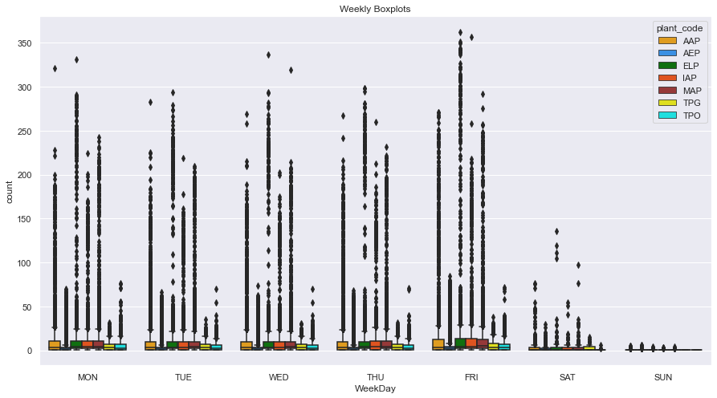
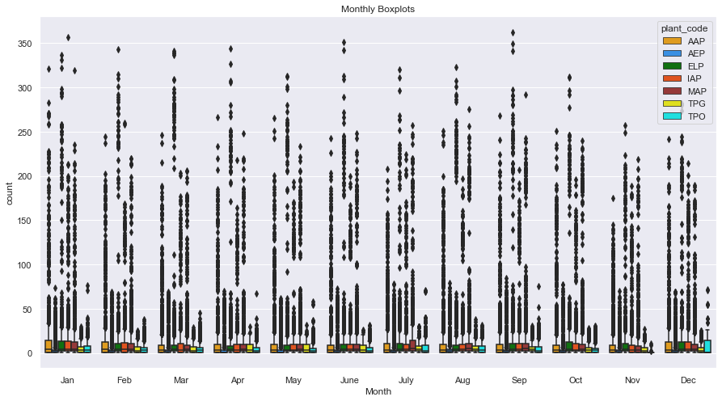
Box plots of Week_wise and Month_wise

Slide 7
(6) Draw the line plots [here we can observe how the count varies along with given attend_dates

Slide 8
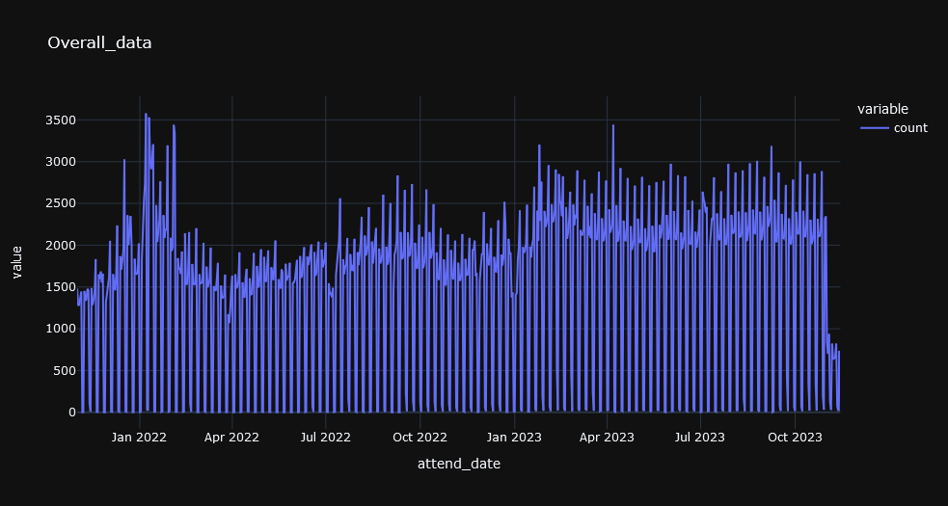
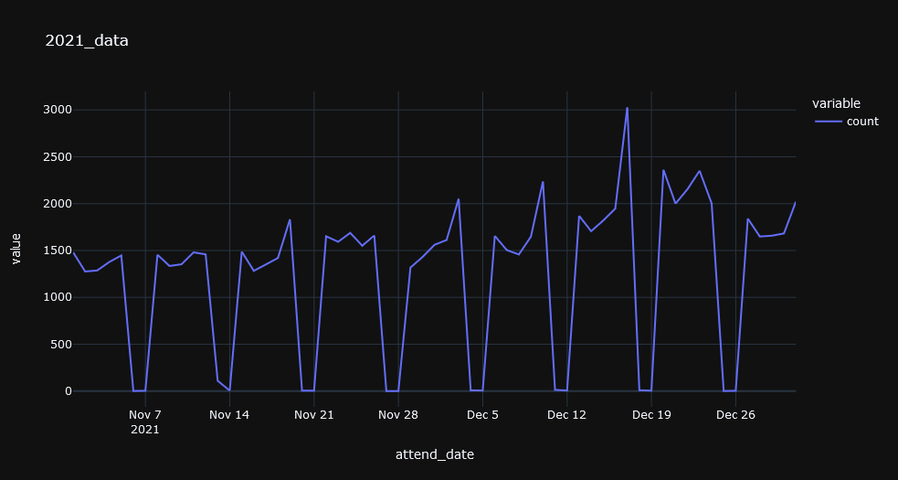
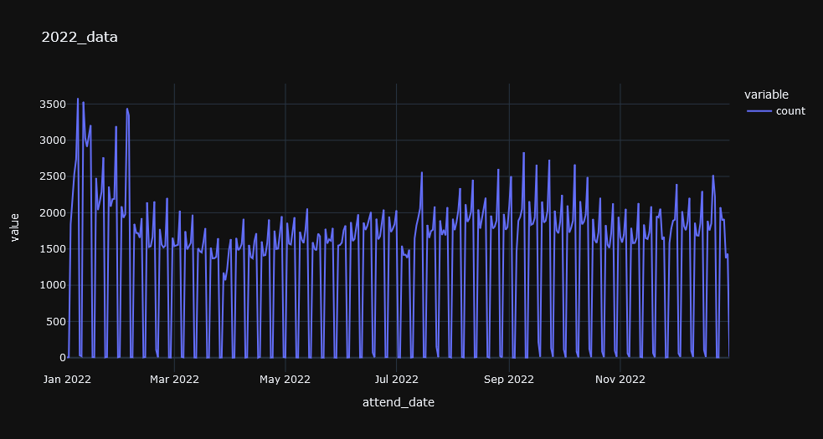
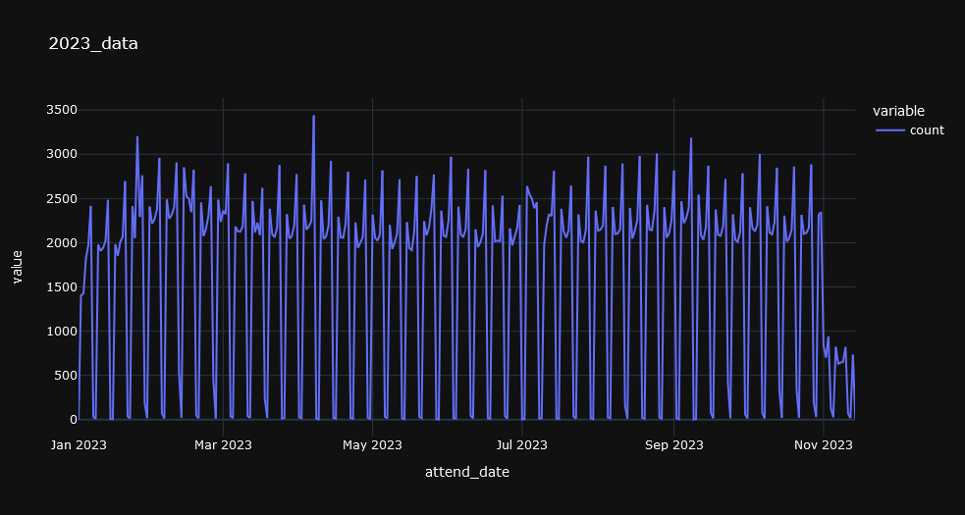
Line plots of [Count vs Overall data] and [Count vs each year]
missing dates replaced with ZERO

Slide 9
(7) Split the data as training and testing[last 2 or 3 months]
(8) Apply regression models on training data, find the best model and fit that model on training data
(9) Find the predictions of test data based on this best fitted model
(10) Calculate the values like MAE, RMSE, Coefficient etc
(11) Draw the Line plots and Bar plots[day_wise and week_wise] to observe the performance of count value and predicted value throughout the attend_dates or weeks.
(12) Draw the Scatter plot between count and predicted values.
(13) Calculate the Accuracy of the model between count and predicted values.
(14) Load the 2nd csv file [related to production_dates]

Slide 10
(15) Calculate the Feature_matrix by applying the filtered test data on 2nd csv file.
(16) Find the Feature_predictions of Feature_matrix based on the best fitted model
(17) Merge the test data [it contains count and predictions] and Feature_matrix data [it contains Feature_predictions]
(18) Calculate the values like MAE, RMSE, Coefficient etc on merged data
(19) Draw the Line plots and Bar plots[day_wise and week_wise] of merged data, to observe the performance of count value, predicted value and feature_prediction values throughout the attend_dates or weeks.

Slide 11
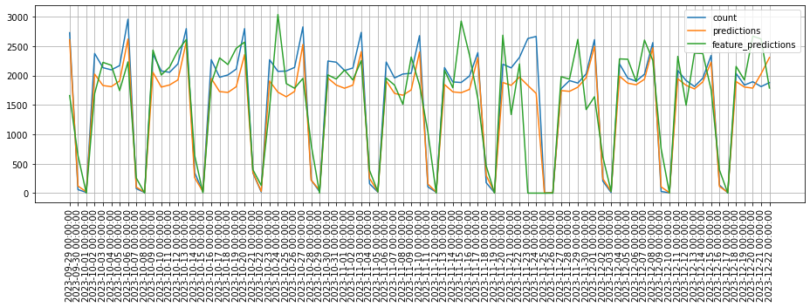

Overall_test-data:
Matrix between actual vs feature predictions

Slide 12
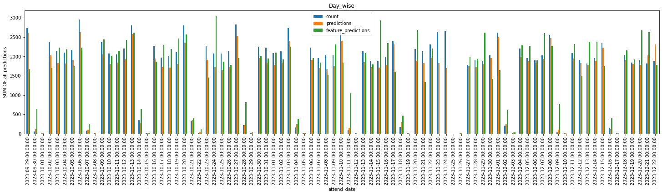
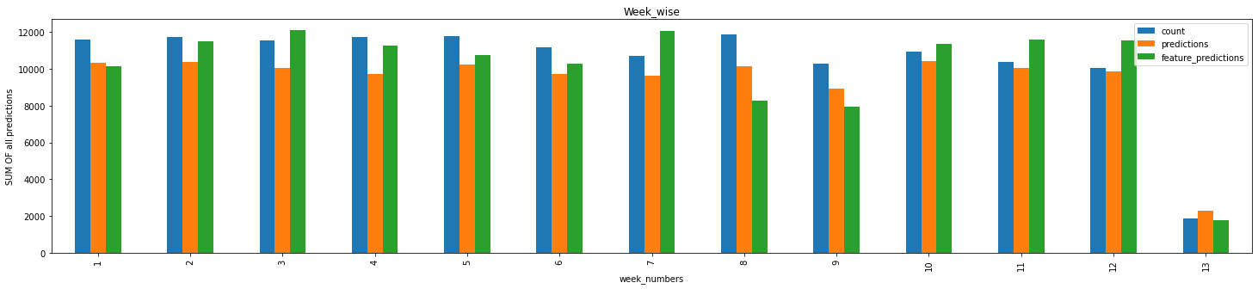

Slide 13
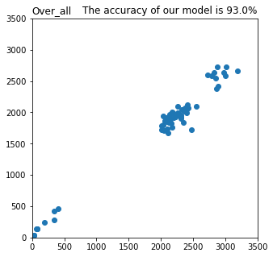
Scatter plot between actual and prediction values
Over all :

